Slide 1

Indicater Placement Presentation 2014-15

Slide 2

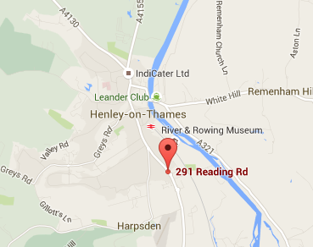


About Indicater
Mike Day
CEO
Lou Wilcock
Founder and Director
Based in Henley
Established in 2000 by mike day and Lou Wilcock
Delivers business management solutions for the hospitality industry
Provides web-based back of house online management systems for business operations such as payroll, sales, patient dining, online booking
Offering over 30 modules of critical business management tools

Slide 3















About Indicater
Providing software solutions for over 2500+ outlets
Good business relations in hospitality industry
Clients
Partners

Slide 4

Job Role and Responsibilities
Worked within a small team of developers and a project manager
Main roles involved testing bug fixes and developments
Monthly software releases
Develop and manage test and integration environments
Documenting system status
Sprint planning and scrum meetings
System handover to new junior tester

Slide 5
Adding Value
Tools Developed
Deployment program
Zip program
File time stamp refresher
Git commit analyser
Automated browser testing (Selenium)
Company Development
Developed the testing department. Doubled in size
Re-specified and improved areas of the systems user interface
Decreased delivery times of developments and fixes
Automation of manual tasks
Documentation of system status

Slide 6
Evaluation
Skills Developed and Learnt
Documentation and analysis skills
Presentation and communication skills
MSRS RDL (Report Definition Language)
C#
SQL queries, stored procedures and database integrity
Versions control software (GIT)
Business Aspects
The importance of data protection handling sensitive data
Changes to internet product standards and its effect within a business
The management and deliverance of software solutions (Software Life Cycle)
The realism of software specifications
University Modules that Complimented the Job Role
Databases
Advanced Databases
HCI (Human Computer Interaction)
Software engineering
Project Management
Programming

Slide 7
Positives and Negatives
Negatives:
Foundations of the system were built with legacy code classic.asp
Hard to get another developers time for help at times
Large turn around in staff just previous before my arrival at Indicater
Areas of system documentation was unclear and in some cases non existent
Positives:
High level or permissions granted access to important areas of the system
Included important meetings and discussions. Encouraged to voice opinions
Working in a small team provided exposure to many areas of the system.
Working with technologies and software that has further developed my technical skills and learnt new ones.

